Slide 1
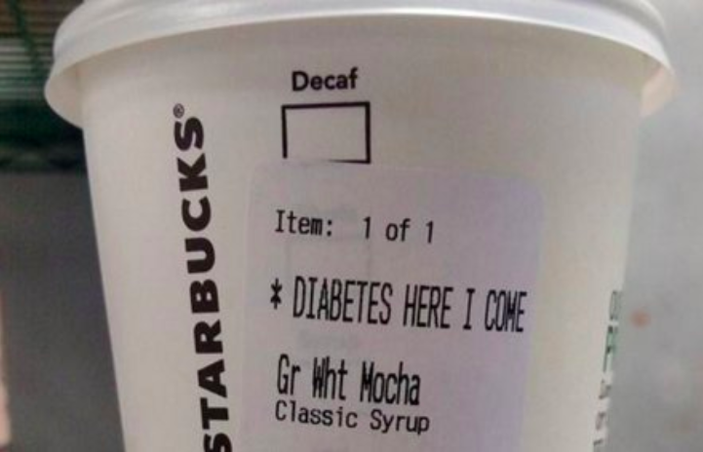
Diabetes
Diabetes and Machine Learning
Giving a shot at feature engineering
Dutch, Fathi and Robert
Digital experience designer
Notes:
Robert

Slide 2

Background on
Prevalence: In 2015, 30.3 million Americans, or 9.4% of the population.
New Cases: 1.5 million Americans are diagnosed with diabetes every year.
Deaths: 7th leading cause of death in the United States (2015), with 79,535 death certificates listing it as the underlying cause of death
Cost: $327 billion/year (2017)
Notes:
Robert
Total cost$237 billion for direct medical costs; $90 billion in reduced productivity
Gun violence: 2.8 Billion
Trump’s border wall: 20-70 billion
Afghan war: 45 Billion a year
Asthma: 80 Billion
Hurricane Harvey: $125 billion
Hurricane Katrina: $161 billion.
Excessive drinking: $249 billion in 2010
Alzheimer's $277 billion
Climate change disasters cost $300 billion in 2017

Slide 3


Data Set & Project Goal
Diabetes data collected from 130 hospitals in the United States from 1999-2008
Over 100,000 rows of data
Goal of model: Determine factors that explain why a diabetic patient will be readmitted in less than 30 days.
Notes:
Robert

Slide 4
Process
Feature Engineering
Data Visualization
Clean
Data
Machine
Learning
Insight
Notes:
Robert

Slide 5
Process
Feature Engineering
Data Visualization
Clean
Data
Machine
Learning
Insight
Notes:
Robert

Slide 6


Data Visualization
Investigate imbalances in data
Determine variables that are best candidates to be predictors
Notes:
Robert

Slide 7
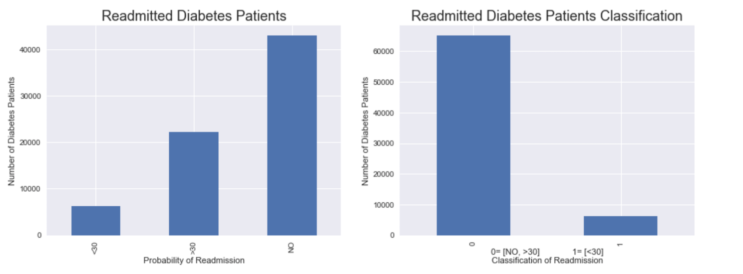
Data Visualization
Notes:
Robert

Slide 8
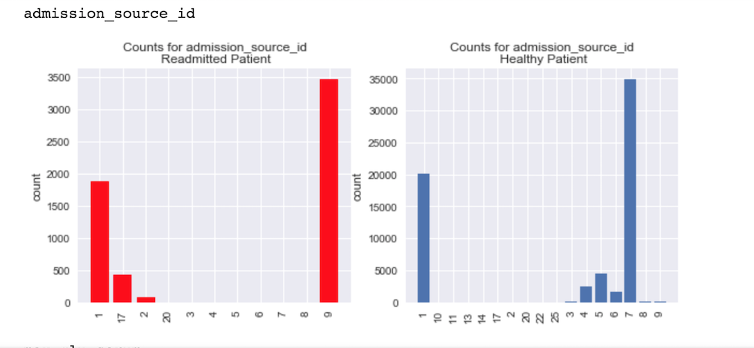
Data Visualization
Notes:
Robert

Slide 9
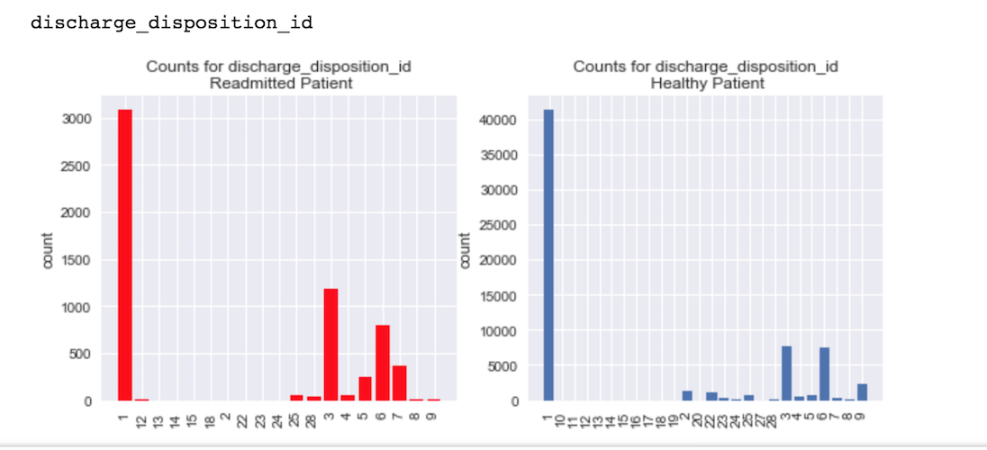
Data Visualization
Notes:
Robert

Slide 10
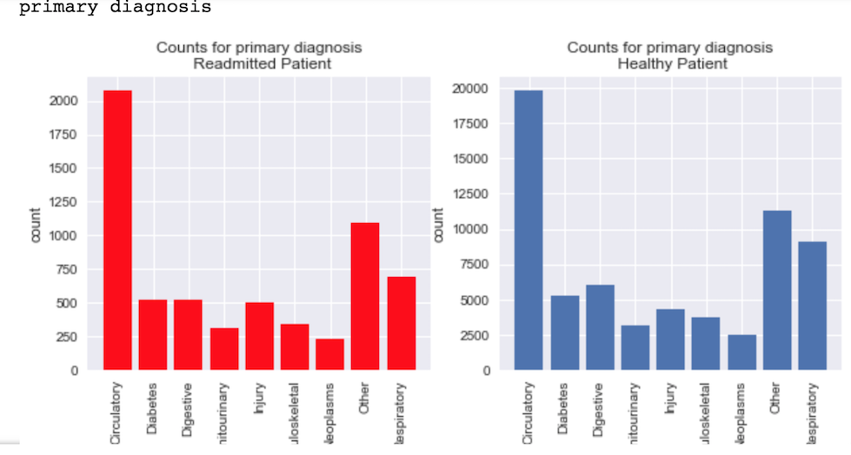
Data Visualization
Notes:
Robert

Slide 11

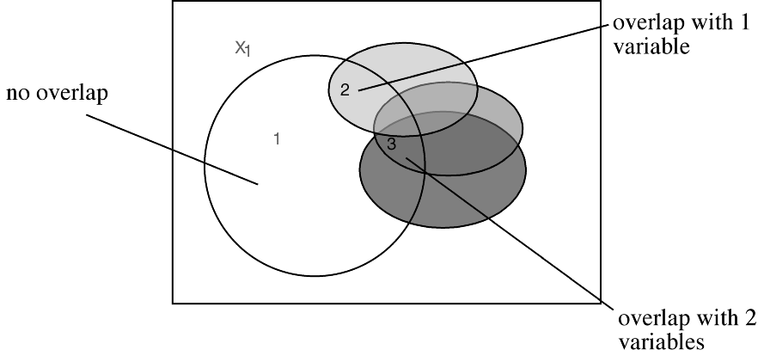
Data Visualization
Stepwise Regression
Based on SPSS analysis, The best predictors and their ranking:
o 1: discharge disposition
o 2: number inpatient
o 3: diabetes Med
o 4: age
o 5: Primary diagnosis
o 6: time in hospital
o 7: second diagnosis
o 8: number diagnoses
o 9: number emergency
Notes:
Dutch

Slide 12
Process
Feature Engineering
Data Visualization
Clean
Data
Machine
Learning
Insight
Notes:
Dutch

Slide 13

Feature Engineering
Transforming data
Coding dummy variables
Notes:
Dutch

Slide 14
Process
Feature Engineering
Data Visualization
Clean
Data
Machine
Learning
Insight
Notes:
Dutch

Slide 15

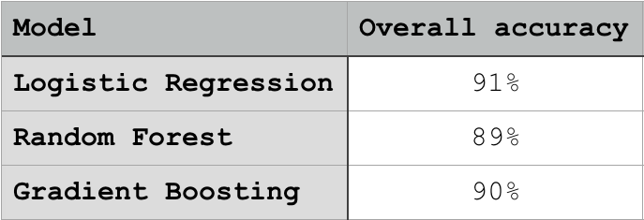
Machine Learning
Notes:
Dutch
Logistic Regressions are best for classification; that’s what we stuck with

Slide 16

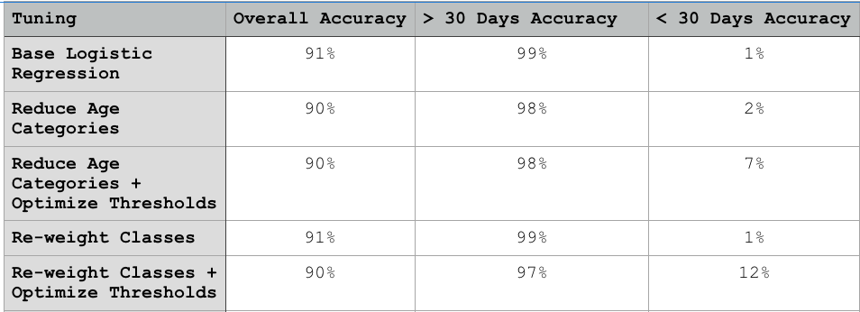
Machine Learning
Tuning the logistic regression model
Notes:
Dutch

Slide 17
Process
Feature Engineering
Data Visualization
Clean
Data
Machine
Learning
Insight
Notes:
Dutch

Slide 18
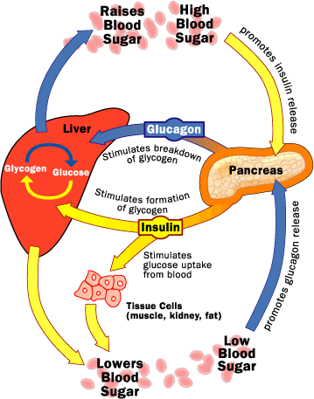
Feature Engineering #2
Eliminate low-variance features
Variance threshold Function
ROC Curve
Create new categories
# Of Variables: 50 → 177 → 21
Notes:
Fathi

Slide 19
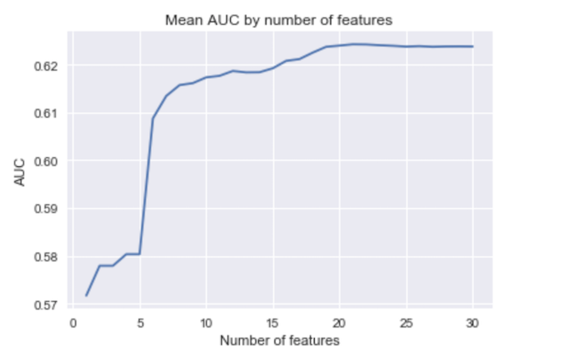
Feature Engineering #2
Variance Threshold Function
Notes:
Fathi

Slide 20
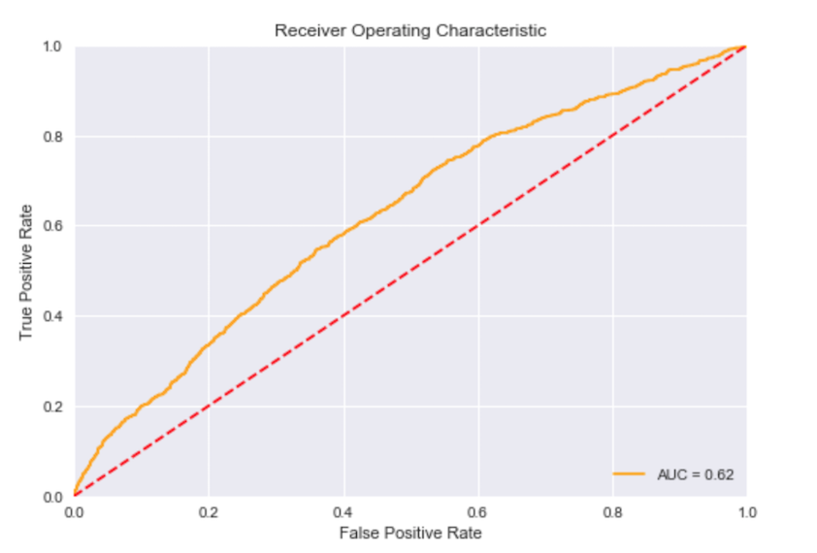
Feature Engineering #2
ROC Curve
Notes:
Fathi

Slide 21
Process
Feature Engineering
Data Visualization
Clean
Data
Machine
Learning
Insight
Notes:
Fathi

Slide 22

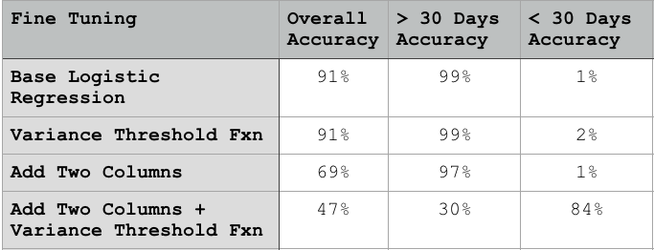
Machine Learning #2
Fine tuning the linear regression model
Notes:
Fathi

Slide 23
Process
Feature Engineering
Data Visualization
Clean
Data
Machine
Learning
Insight
Notes:
Fathi

Slide 24


Key learnings
Machine Learning = Model Tuning
What is more important, and accurate zero or an accurate 1?
Machine learning algorithms are tools that drive insights.
Notes:
Dutch

